Slide 1
Cyber Infrastructure for Molecular Science Communities
Sudhakar Pamidighantam
Department of Chemistry and
Cyberinfrastructure Integration Research Center
Indiana University
pamidigs@iu.edu
Cybertraining Workshop 14 June 2021

Slide 2
Outline
What is cyberinfrastructure and Science gateway
Apache Airavata Collaboration Platform
SEAGrid Science Gateway
CIRC Collaborations

Slide 3



Acknowledgements

Slide 4
Cyberinfrastructure
Laboratory, Local to Campus, State, National and International Resources of Data, Computing, Networks and Software frameworks integrated together to provide seamless access to the scientist for research and teaching.
NSF Supercomputer Centers XSEDE, Frontera, Regional and Local systems

Slide 5
NSF CIF21 Major Areas
Organizations
Universities, schools
Government labs, agencies
Research and Medical Centers
Libraries, Museums
Virtual Organizations
Communities
Expertise
Research and Scholarship
Education
Learning and Workforce Development
Interoperability and operations
Cyberscience
Scientific Instruments
Large Facilities, MREFCs, telescopes
Colliders, shake Tables
Sensor Arrays
- Ocean, environment, weather,
buildings, climate. etc
Discovery
Collaboration
Education
Data
Databases, Data repositories
Collections and Libraries
Data Access; storage, navigation
management, mining tools,
curation, privacy
Computational Resources
Supercomputers
Clouds, Grids, Clusters
Visualization
Compute services
Data Centers
Networking
Campus, national, international networks
Research and experimental networks
End-to-end throughput
Cybersecurity
Data
Infrastructure
Program
Advanced Computational Infrastructure
Software
Applications, middleware
Software development and support
Cybersecurity: access,
authorization, authentication

Slide 6
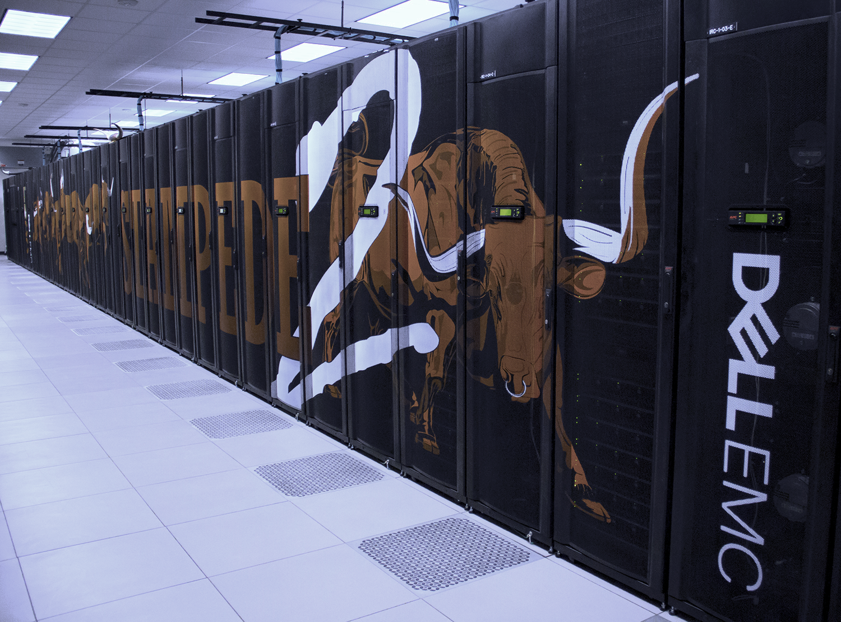
Current XSEDE Resources
Resource | Organization | Type
HP/NVIDIA Interactive Visualization and Data Analytics System (Maverick) | TACC | vis
IU/TACC (Jetstream) | Indiana U | compute
IU/TACC Storage (Jetstream Storage) | UT Austin | storage
LSU Cluster (superMIC) | LSU CCT | compute
Open Science Grid (OSG) | OSG | compute
PSC Bridges GPU (Bridges2 GPU) | PSC | compute
PSC Large Memory Nodes (Bridges2 Large) | PSC | compute
PSC Regular Memory (Bridges2) | PSC | compute
PSC Storage (Bridges Pylon) | PSC | storage
SDSC Comet GPU Nodes (Expanse GPU) | SDSC | compute
SDSC Dell Cluster with Intel Haswell Processors (Expanse) | SDSC | compute
SDSC Medium-term disk storage (Data Oasis) | SDSC | storage
Stanford University GPU Cluster (XStream) | Stanford U | compute
TACC Data Analytics System (Jetstream) | TACC | compute
TACC Dell/Intel Knights Landing, Skylake System (Stampede2) | UT Austin | compute
TACC Long-term Storage (Jetstream Storage) | TACC | storage
TACC Long-term tape Archival Storage (Corral) | TACC | storage

Slide 7
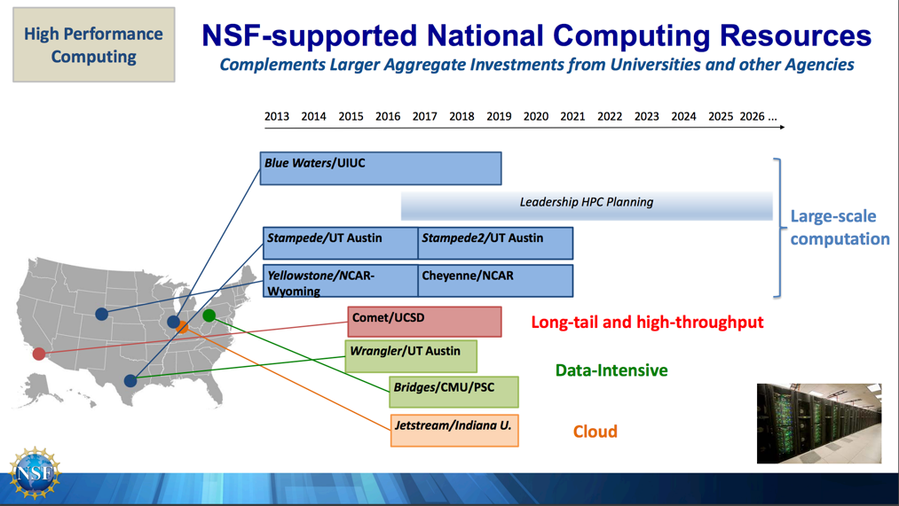
NSF HPC Resources
Frontera
Expanse
Bridges2
Jetstream2

Slide 8
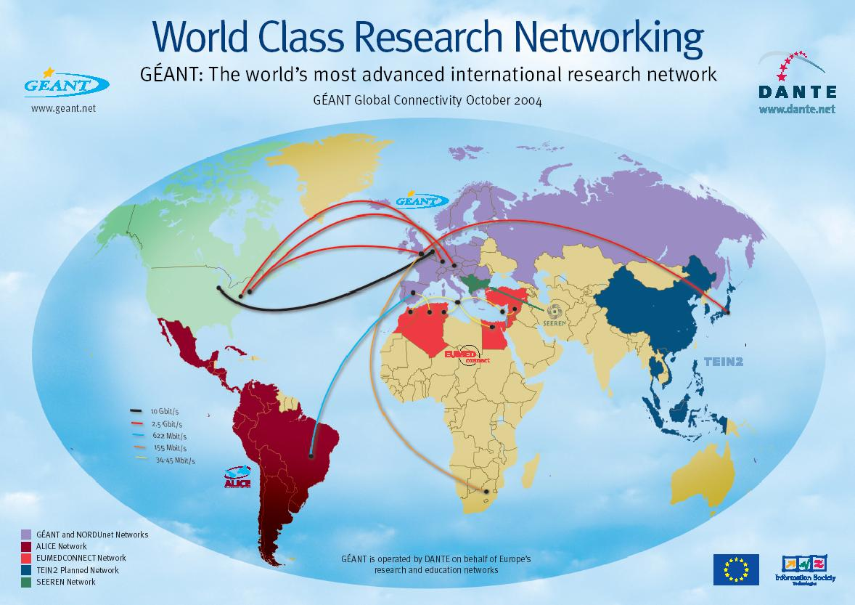
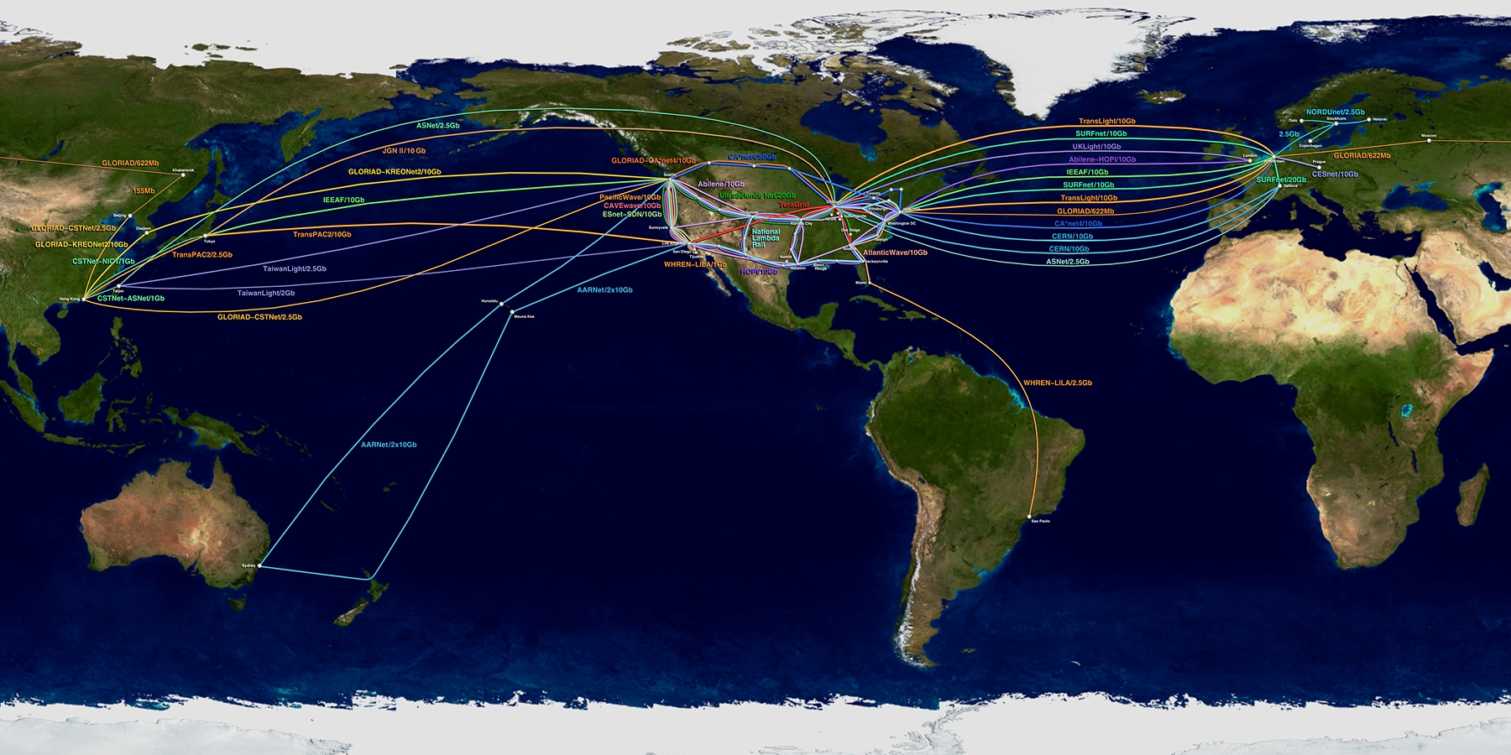
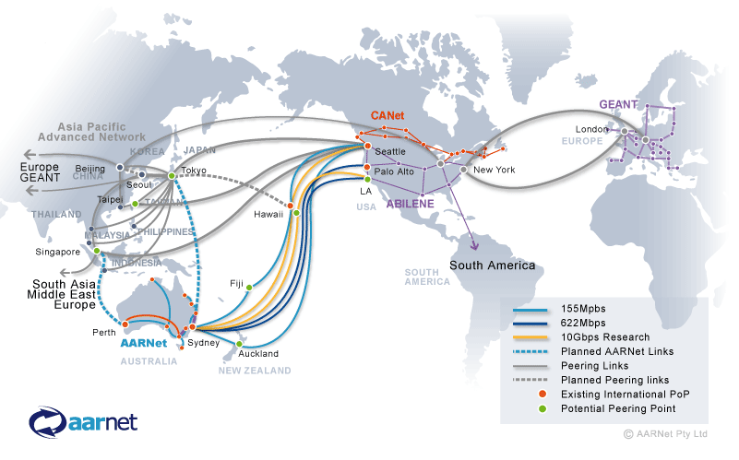
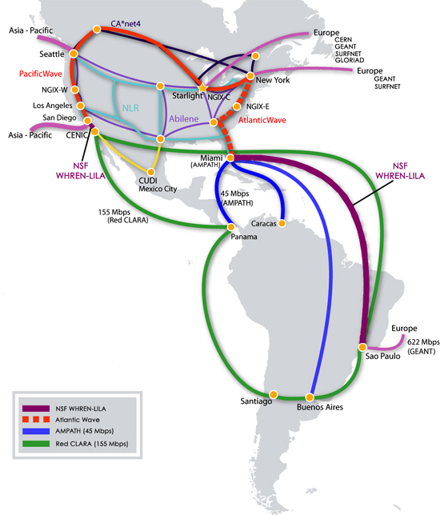
VO-Global: International R&E Networking
Notes:
* at the level of the network fabric, EGEE and the US are well connected: in Europe, DANTE's GEANT2 backbone, and in the U.S., our federal r&e networks, espially Internet2's Abilene, enjoy connectivity across the Atlantic via multiple 10 Gbps links (2 of which are supported by OCI's IRNC program).

Slide 9
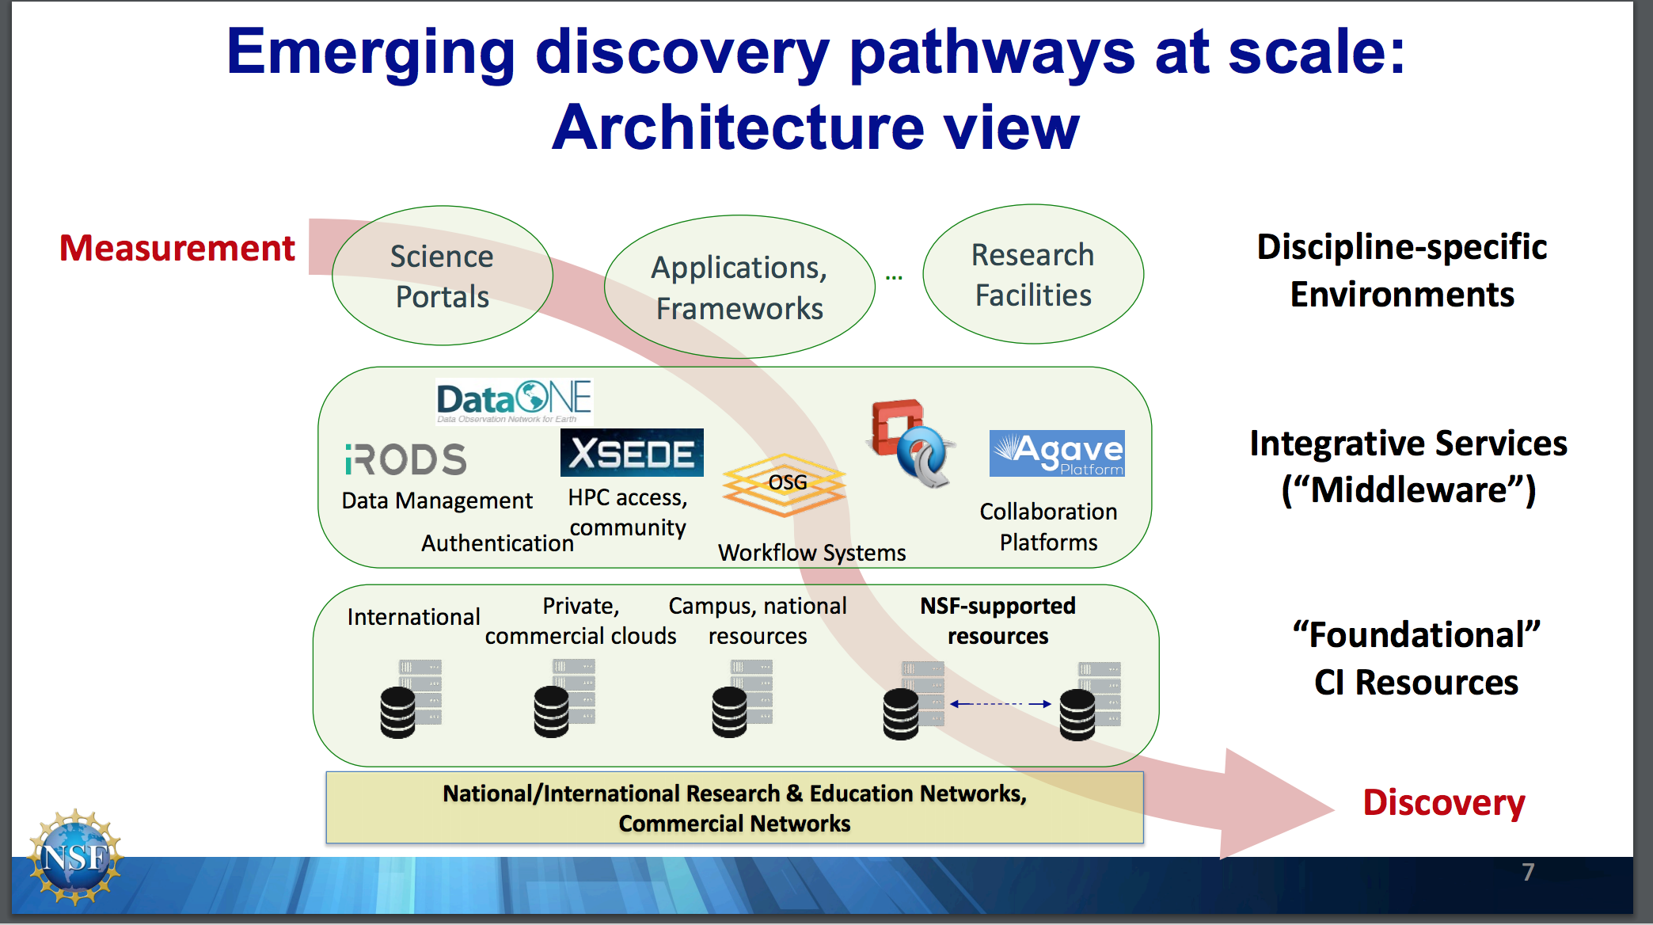

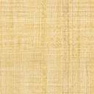

Slide 10
Science Gateways
Web interfaces and middleware for integrating distributed computing, automating expertise, controlling access, managing results, and speeding up your critical computational workflows
Science gateways are Web and desktop interfaces to high performance computing clusters, computing clouds.
Science gateways encode expertise
Running specific scientific application
Running jobs on diverse, nonlocal machines
Moving data to and from world-wide resources
Science gateways enable sharing of results
Science gateways make results recoverable and reproducible

Slide 11
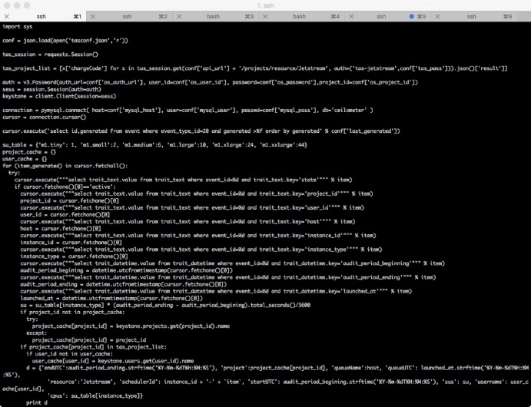
Technology Adoption Choices
Notes:
Jeff Z: Left: the code and the right is the user interface

Slide 12

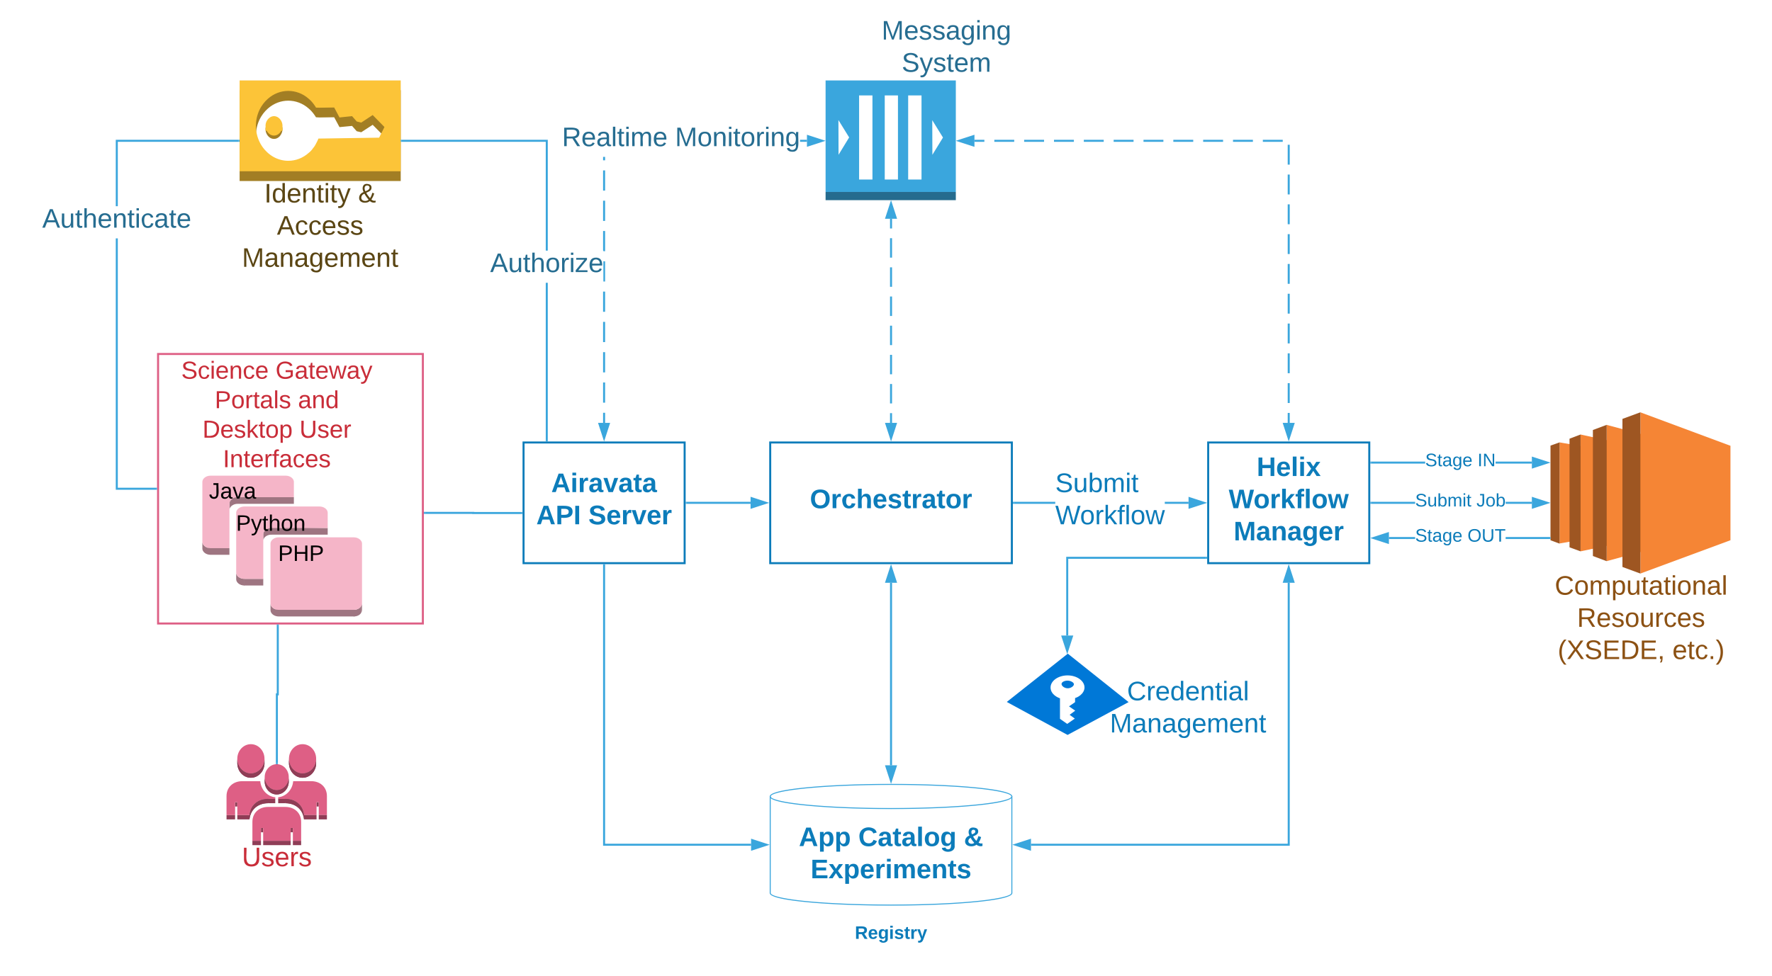
Apache Airavata
Open source science gateway framework (airavata.apache.org)
Enable sharing of
Applications
Compute/storage resources
Simulation results
API and full-featured UI clients
Notes:
User interfaces redirect user to Identity & Access Management service to log in the user and retrieve access token
All interaction between UI and Airavata occurs through the API server which is an API gateway to the functionality in Airavata
To launch a computational experiment, UI registers input files with the API and then saves and launches a description of the experiment
Airavata keeps track of the experiment and updates its status as it progresses

Slide 13
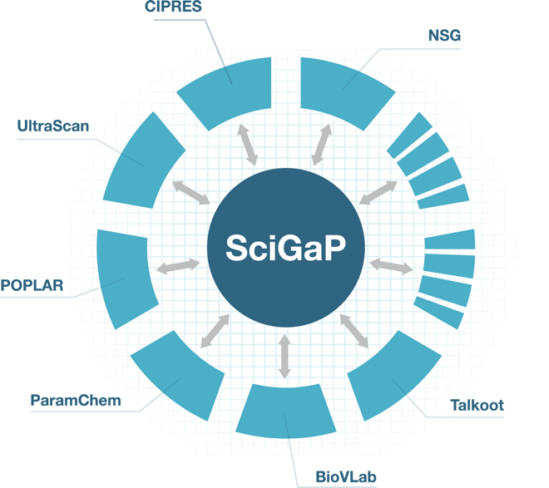
SciGaP Hosting Services
Airavata is multi-tenanted
The SciGaP project runs a hosted instance of Airavata, supports 30+ science gateways
Web Portal hosting
Common use case: Software-as-a-service science gateway
Consulting help also available
Request a gateway at https://scigap.org
Sustainably operated by SGRC after NSF funding through NSF SI2 program
Notes:
Because Airavata is multi-tenanted, it is relatively easy to support many science gateways on a single running instance of Airavata middleware
Software-as-a-service science gateway: Someone has code or codes they want to make available via a gateway, so SciGaP helps them do it. Examples: Searching SRA, dREG, SimVascular, UltraScan and SEAGrid

Slide 14
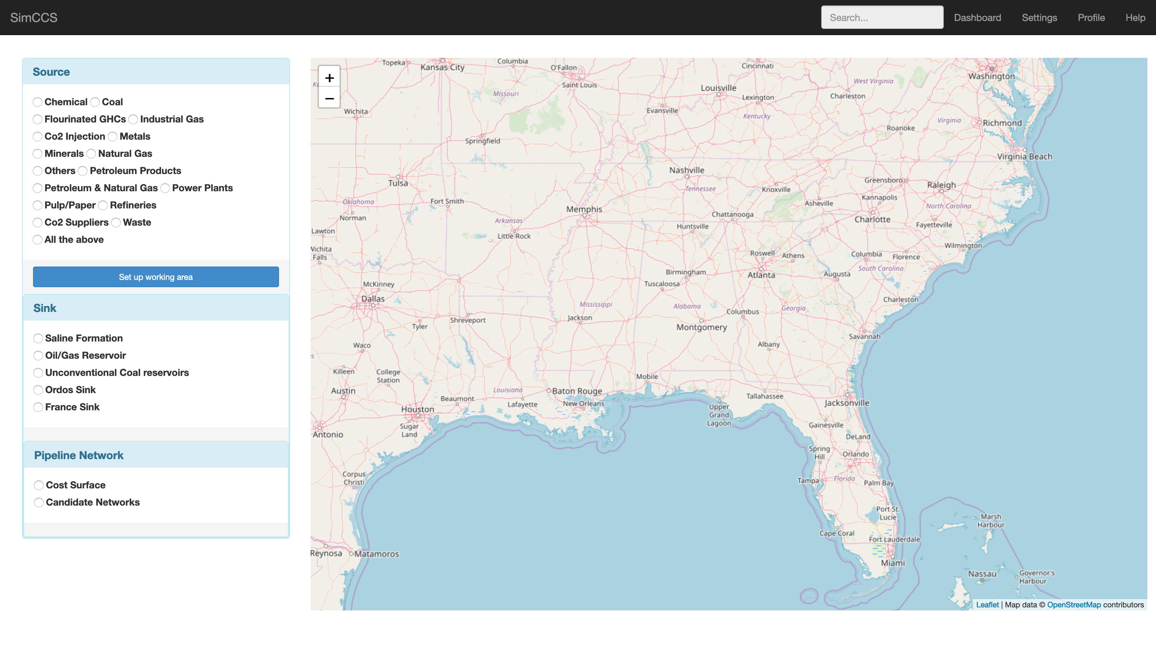
Building an Airavata client
Option 1: Build your own
Option 2: Build extensions to Django Portal
Thrift based API
Clients exist in Java, Python, PHP, but many more target languages possible
Example code is available
New Django Portal (beta)
production availability this summer
Extensibility
Add additional Django apps
Custom experiment input editors
Custom experiment output viewers
Leverage REST API and JS libraries
PHP
Java
C++
Thrift IDL
Py
Example custom Django app: SimCCS Maptool
Notes:
API server exposes an API defined by Thrift IDL for interacting with Airavata
Thrift makes it easy to generate API clients in almost any language
We’re currently working on a new portal user interface implemented on the Django framework and built from the ground up for extensibility

Slide 15
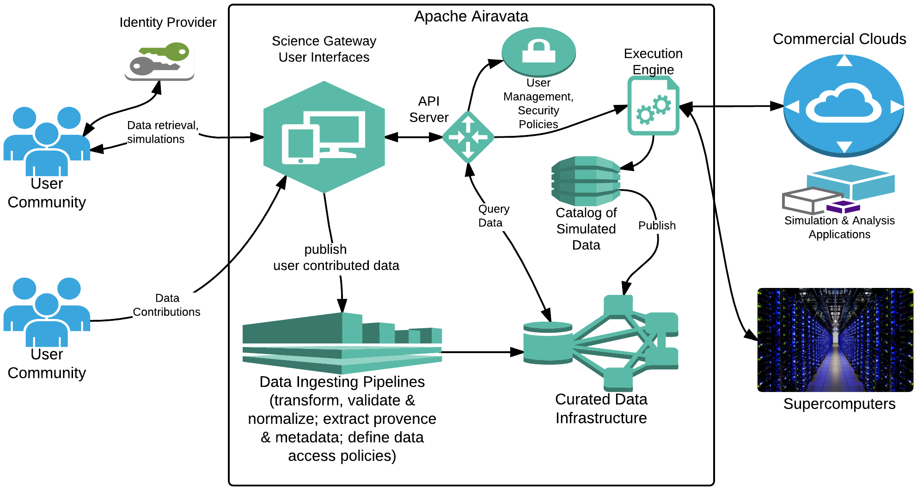
Science Gateway Architecture
Notes:
Jeff Z: Remove branding, remove Apache Airavata from box. Stay on message. Get rid of logos at the bottom, concentrate on content and message. Too much lingo. Concentrate on what you can do for the user. Extract provenance, metadata, data ingestion pipelines, etc are all terms that people won’t know.
Next slide: would be good to talk about the User Interface

Slide 16
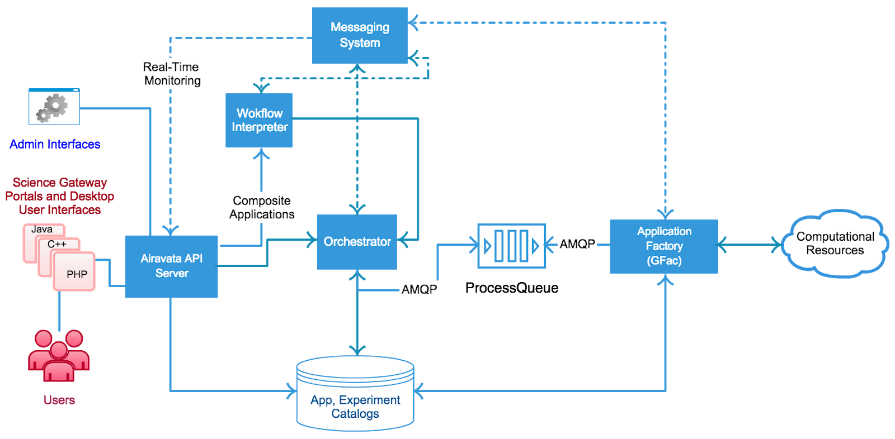
Helix Task Execution Framework

Slide 17
What Is Apache Airavata?
Apache Airavata is software for building science gateways.
Don’t start from scratch
Airavata-based gateways integrate clusters and supercomputers from all over the world.
We can make your resources available to your team.
We can help you access supercomputers, clusters, and computing clouds from outside your institution or enterprise.

Slide 18
Some Gateways Built with Apache Airavata
Gateway | Description
UltraScan | Support for data analysis of analytical ultracentrifugation experiments
GeoGateway | Earthquake modeling and data access to support NASA and other researchers
IU Cybergateway | Campus gateway for accessing campus resources (in revision)
University of South Dakota Gateway | Campus gateway specializing in chemistry and bio applications. Other campus gateways: Oklahoma University , University of Utah, Georgia State University
dREG Science Gateway | Gateway for locating and understanding Transcriptional Regulatory Elements (TREs) that encode the temporal and spatial patterns of gene expression.
Oklahoma Innovation Institute Gateway | Gateway for computational chemistry and engineering applications
PHASTA Gateway | Gateway for computational engineering, finite element simulation
For a complete list, please see https://circ.iu.edu/collaborations.html
Notes:
Recast this as “Five most widely used gateways built by the SGRC”. Move this slide up (see earlier).

Slide 19
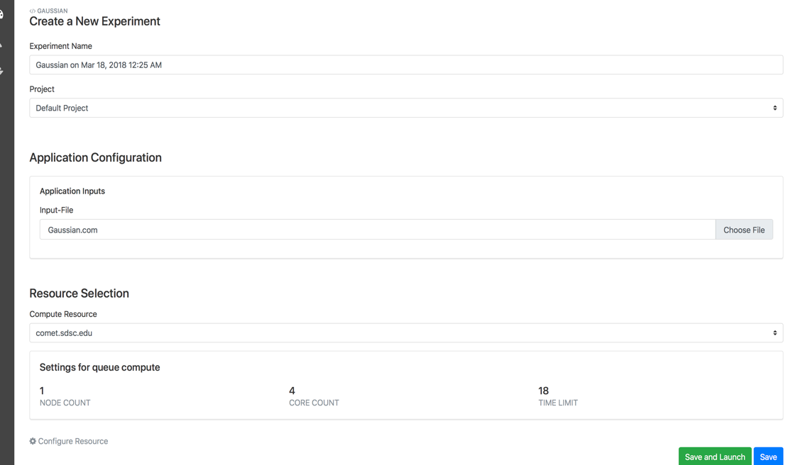
Django Portal
Portal Page
Django
Python High level API
Airavata API Client
Dynamic UI
REST API
Airavata Middleware
CustUI Comp
Web Browser
Web Server
Notes:
* We're reimplementing the PGA as a Django web application, but now no longer a reference implementation, instead a UI platform
* Each portal page contains dynamic UI components that talk to a REST API that bridges calls to the Airavata API
* With a real UI component model, gateway developers will be able to create custom, domain-specific UI components

Slide 20
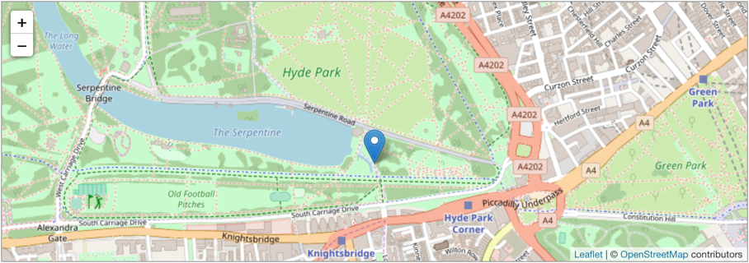
Custom UI Components
Image credit: leafletjs.com website
Image credit: jmol.sourceforge.net website
Notes:
Not just a reference implementation but a UI platform on which custom UI components can be built
Custom UI component types:
Application input editor
Application output visualizer
Custom application specific experiment editor

Slide 21
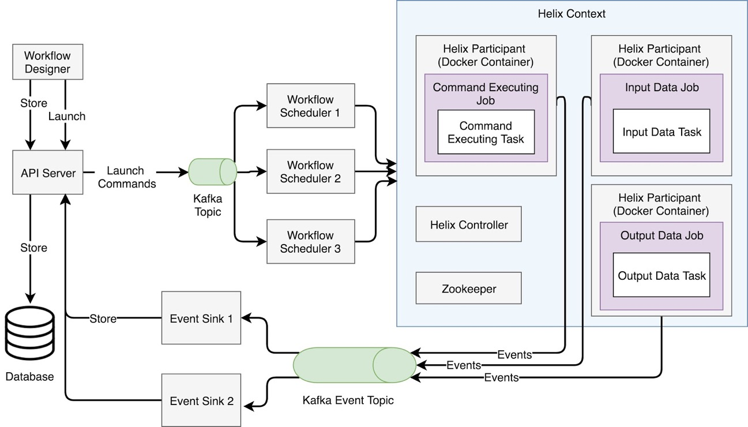
Helix-based Task Execution
Notes:
Apache Helix is “A cluster management framework for partitioned and replicated distributed resources”
The most relevant part of Helix for Airavata is the task framework
Helix task framework has a notion of workflows, jobs and tasks, and jobs can be arranged in a DAG to make a Workflow
Nodes that provide task implementation are called Participants
The idea is to put each Helix participant into its own Docker container, so each Task implementation is in its own container
This will simplify adding a new Task implementation, even into a production Airavata deployment
Helix will simplify creating new workflows out of existing Task implementations

Slide 22
Group-based Authorization
Currently, authorization based on statically defined roles
Group-based authorization gives gateway admins more fine-grained control
But also opens the door to allowing users to share resources and applications with other users
Notes:
Currently authorization is based on statically defined roles, leading to a hierarchical structure: only Gateway admins can add new applications or define and share resources.
Group based authorization will allow any user to create applications and resources in the gateway and share them with whomever they want
Also allows for more fine grained authorization, when a gateway admin wants to share an application or resource with only certain users

Slide 23
Apache Airavata Summary
Apache Airavata has been used as the basis for several kinds of gateways, Single Application, Campus, Domain Specific, Multi-disciplinary etc..
We can integrate Workflows, Data and Metadata, Data reuse mechanisms, sharing and Group wise access control
Apache Airavata is Open Source Open Community software framework and can accommodate contributors from many disciplines
Education, Training, Work-force development opportunities to get involved are available

Slide 24

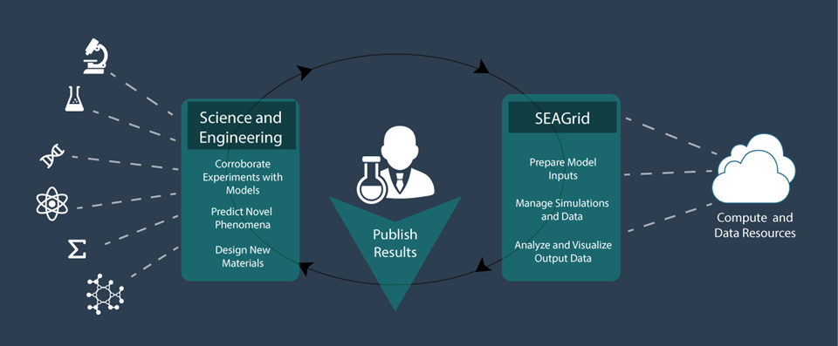
SEAGrid.org is an Apache Airavata-powered gateway

Slide 25
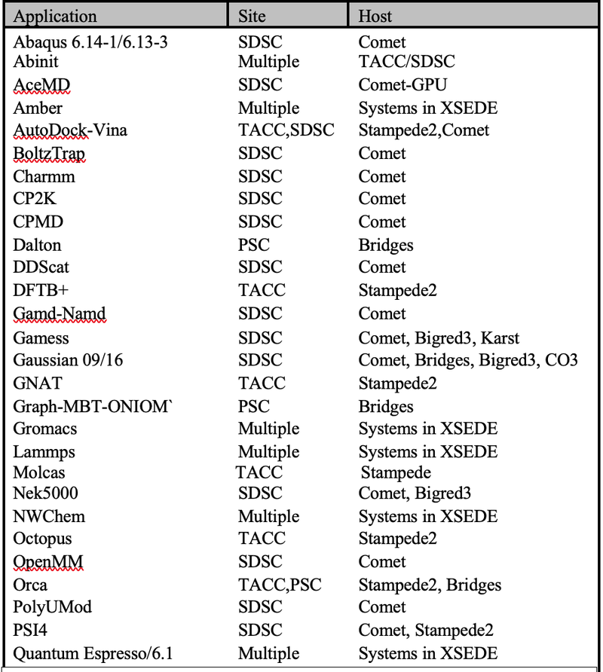
SEAGrid 16 Years in Service
NSF XSEDE Gateway 2021 Allocation valued at $2,974,326.00
NSF XSEDE Resources NCSA, SDSC, TACC, PSC, IU, LSU
Bigred3 and Carbonate (IU), CCR U. Buffalo
1662 Registered Users, ~ 400 Active
222M XD SUs for 222K Jobs Since 2005
More than 80 Publications since 2015
Mainly Chemistry Applications
Desktop Client for Pre and Post processing
Dynamic Information Services (RSS, HPC Load
data, Queue Prediction) Inherent workflow
capability – Checkpoint Reuse, High throughput
and Coupled Applications
Allocations, PI specific user and resource management and
Job level usage monitoring
Consulting – Adaptive Services
Data Archive

Slide 26
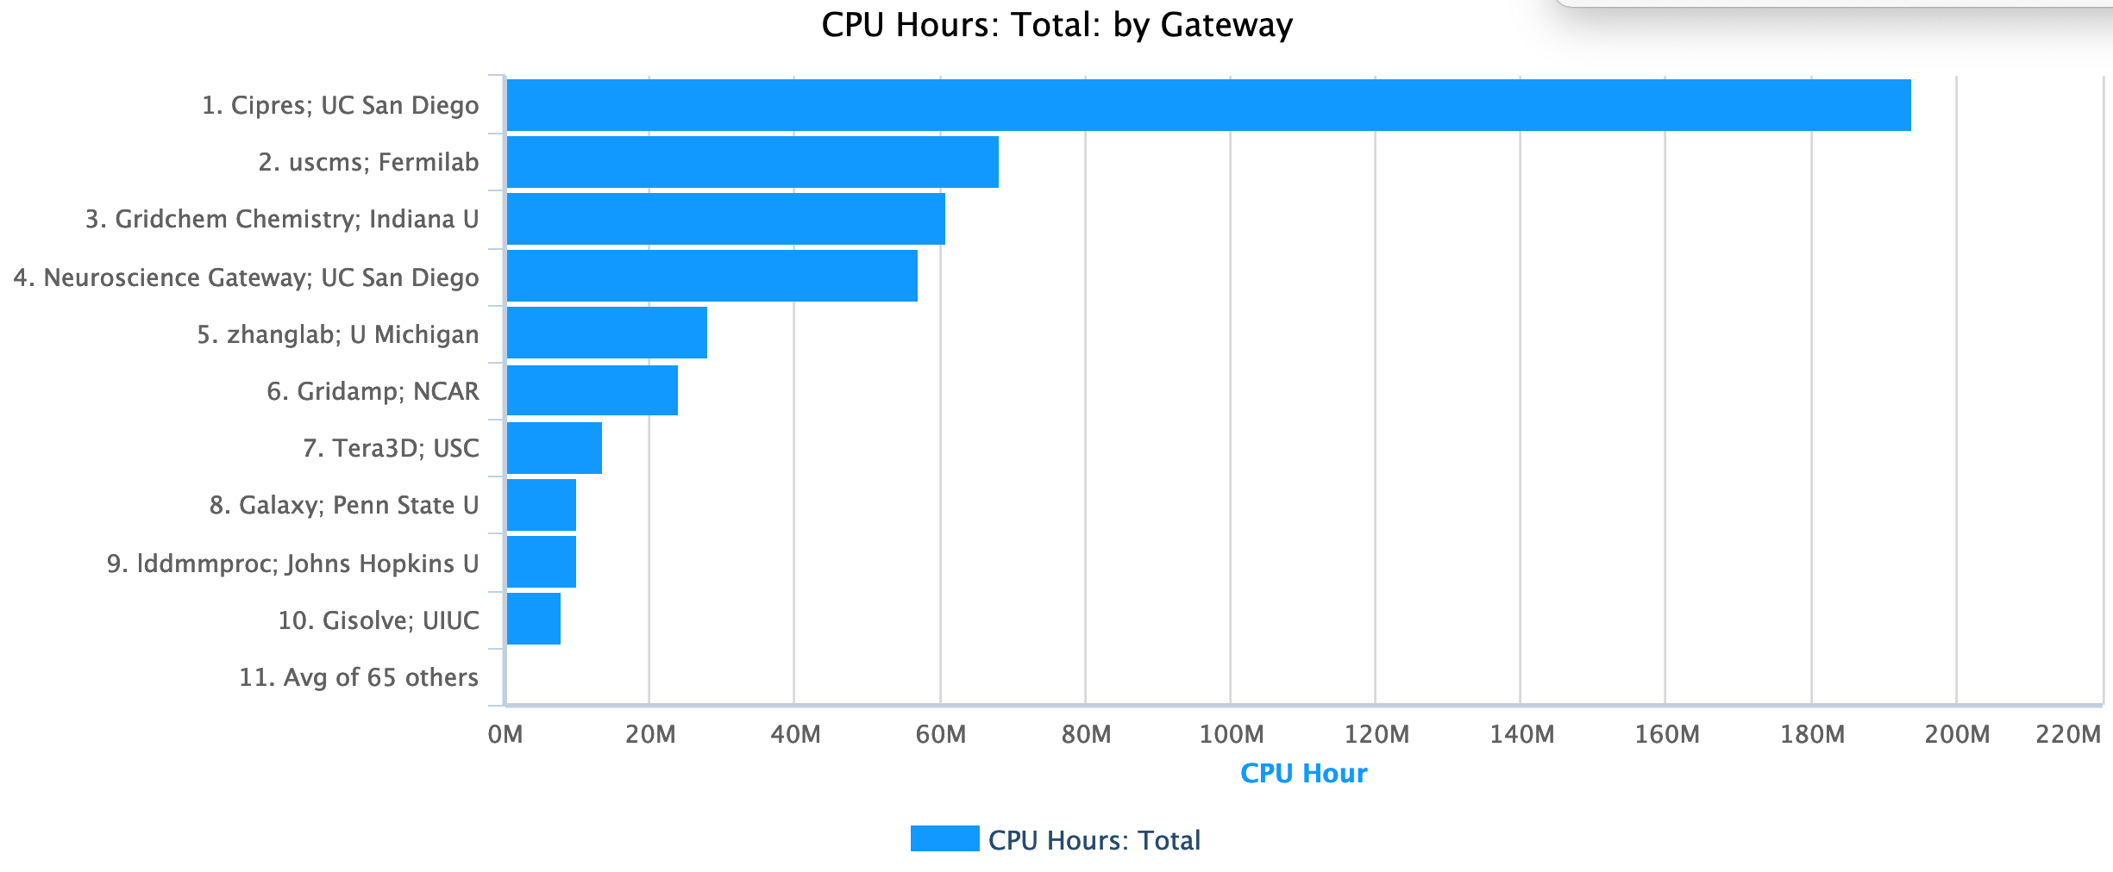
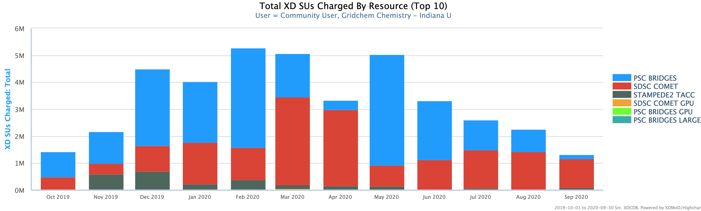
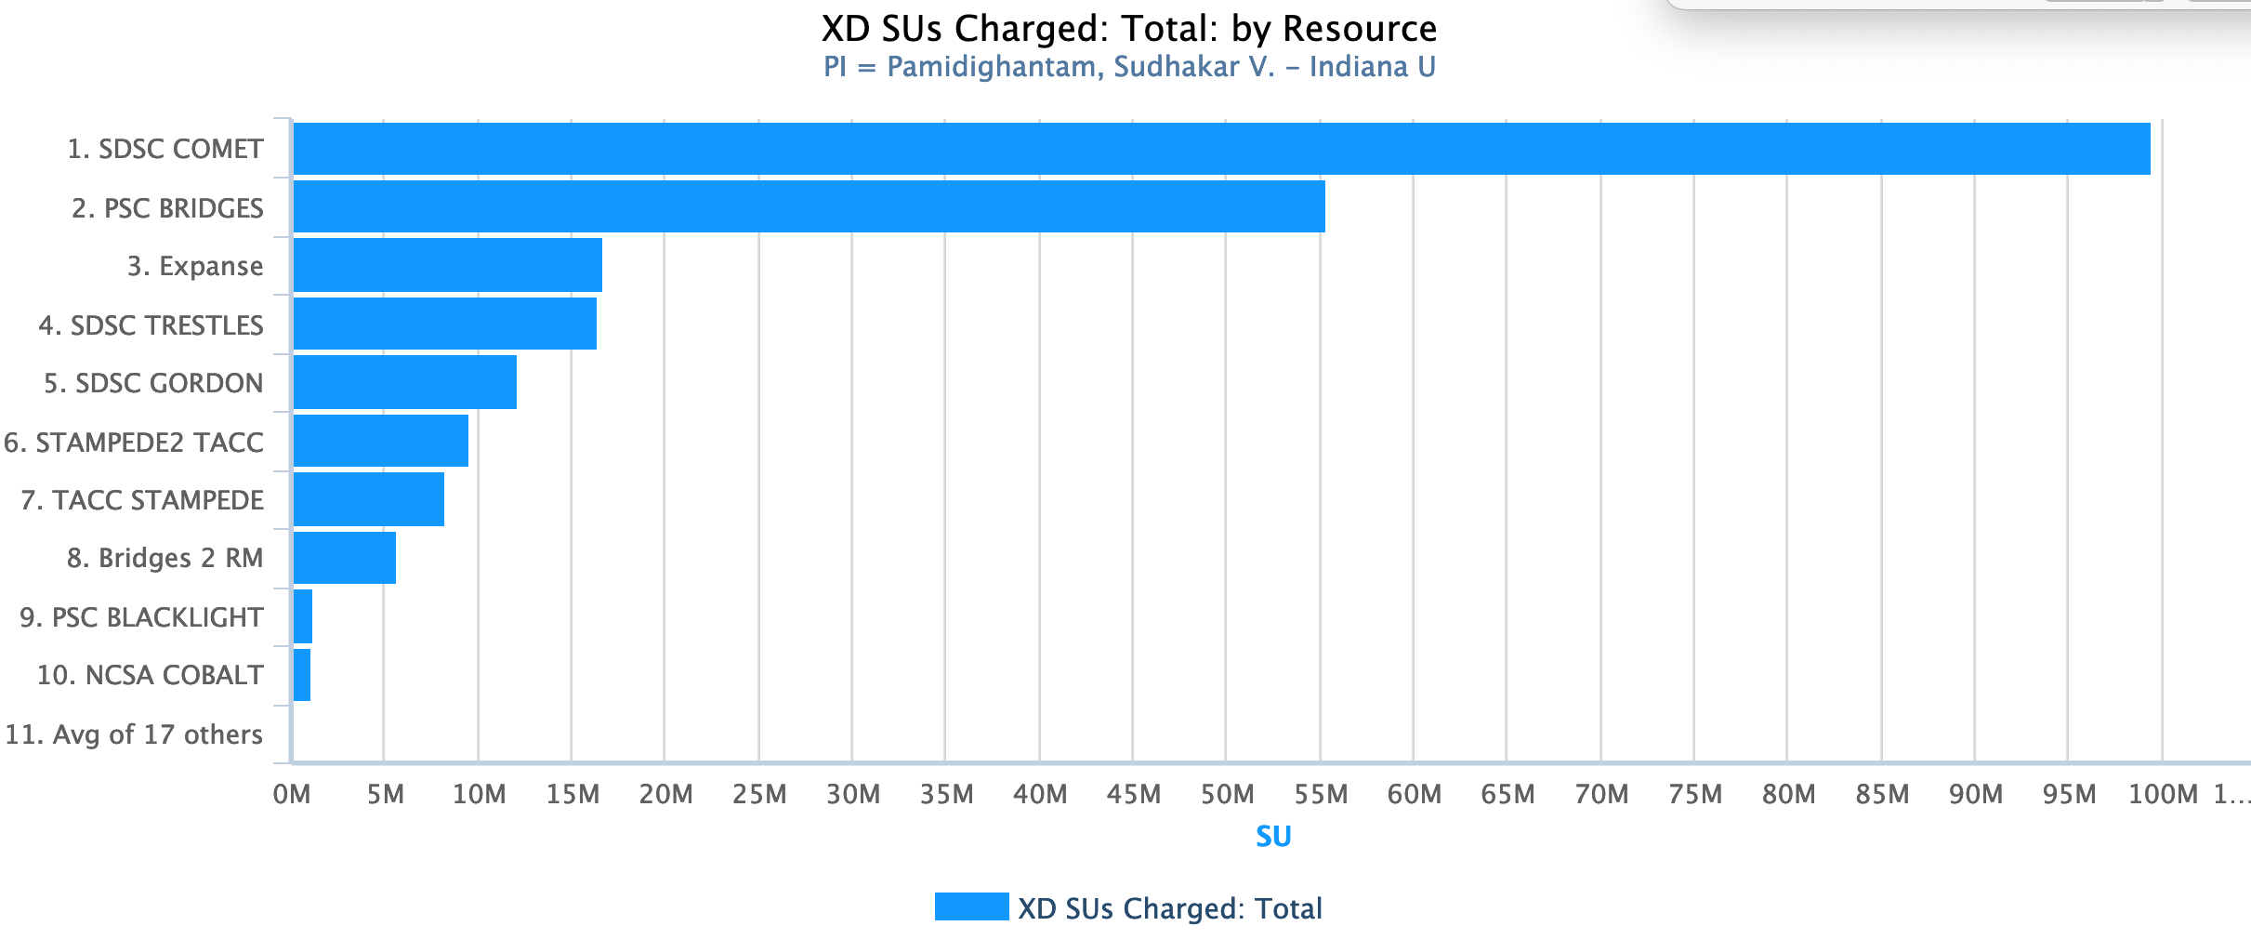
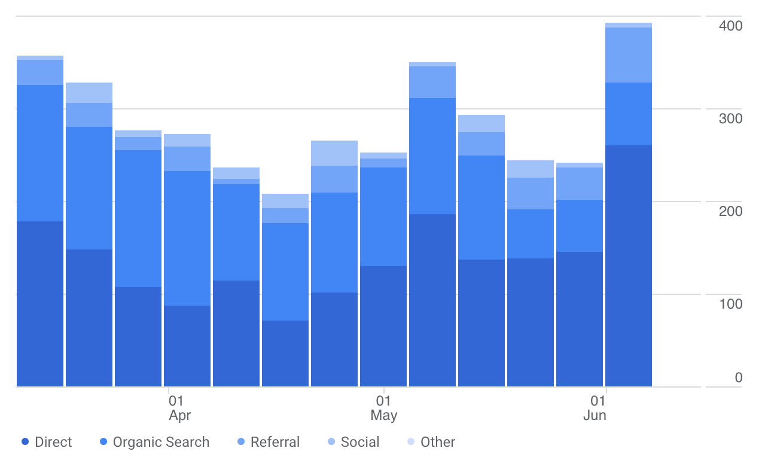
SEAGrid Usage
Among All Gateways in XSEDE
Figure12. XSEDE wide usage for SEAGrid Science Gateway since Oct 2019.
Google Analytics User Counts

Slide 27
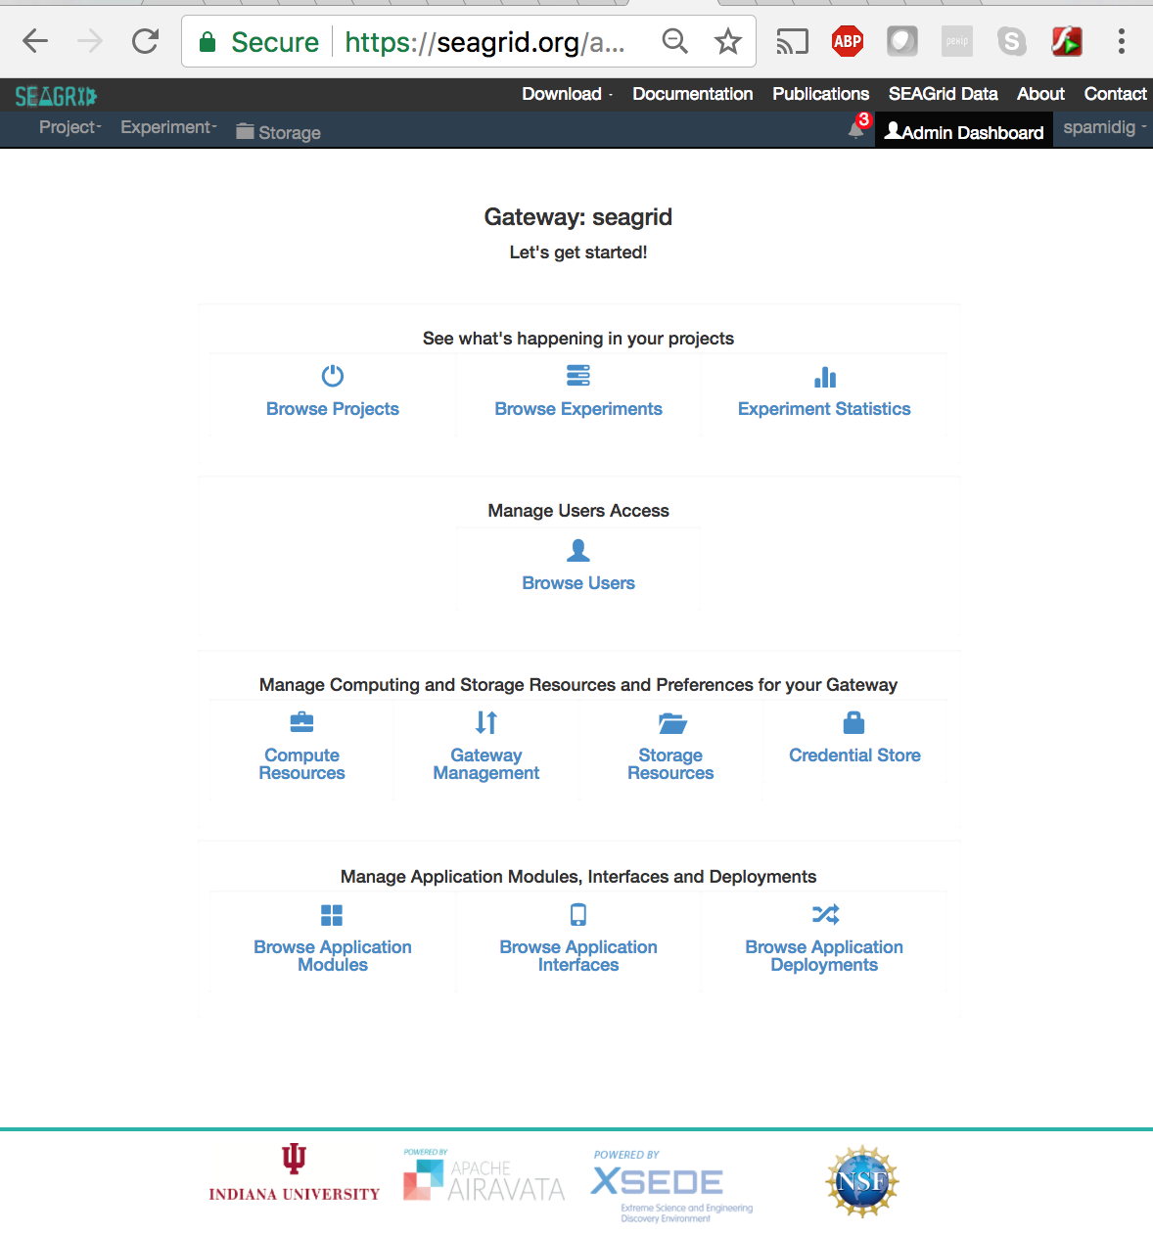
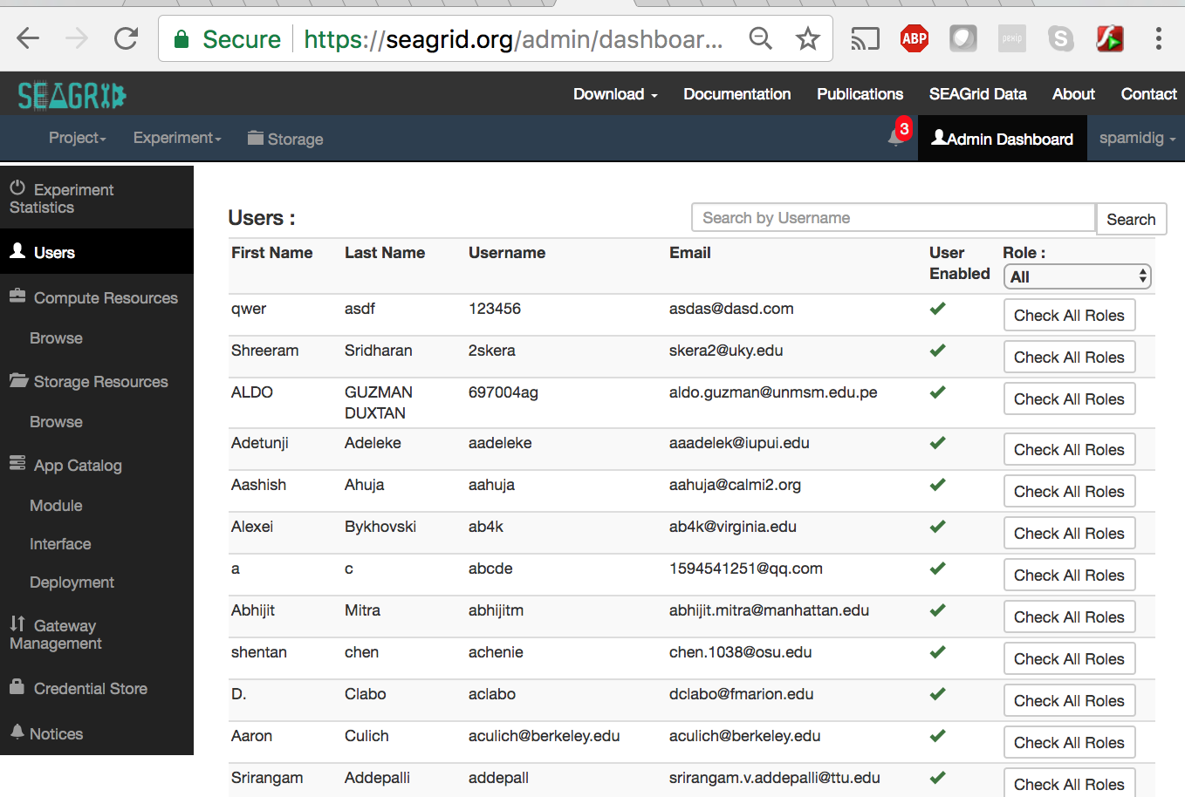
SEAGrid Gateway Admin View

Slide 28
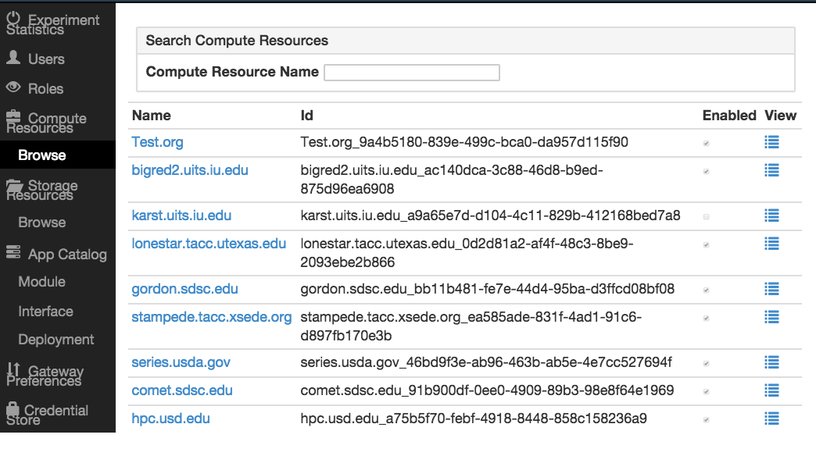
SEAGrid Admin Dashboard Compute Resource Browser

Slide 29
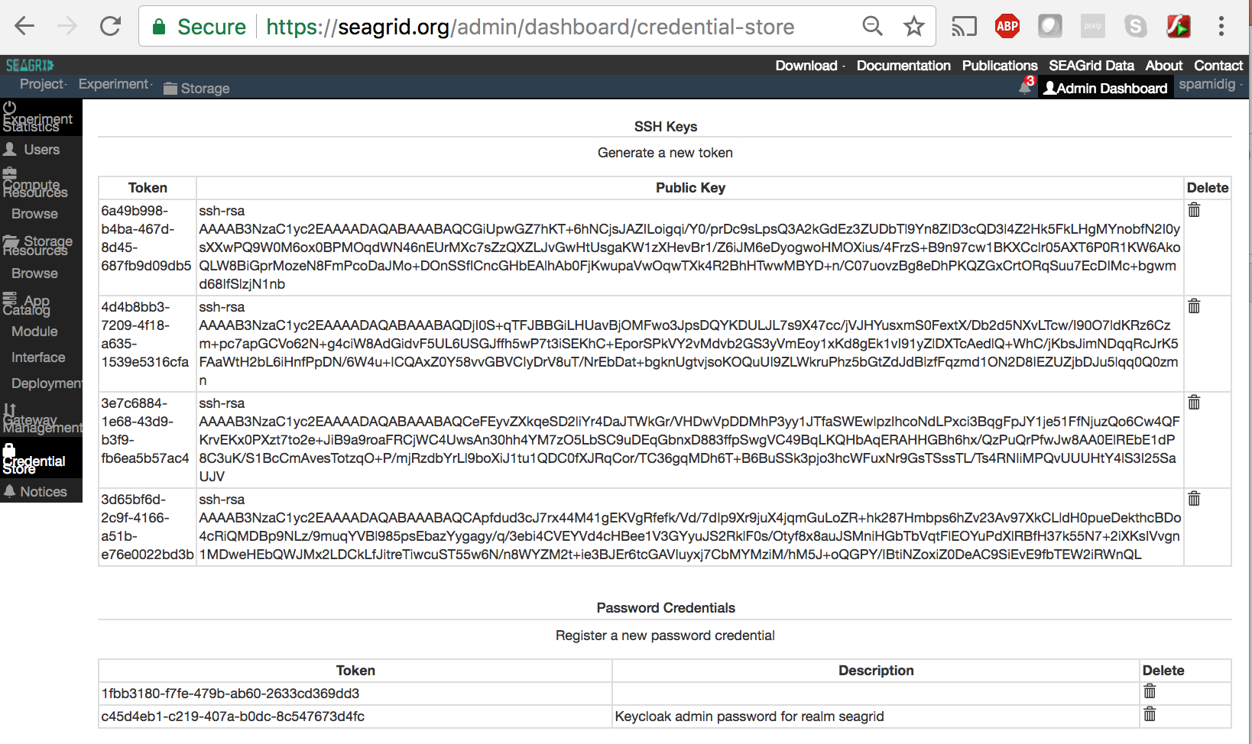
SEAGrid Gateway Credential Store

Slide 30
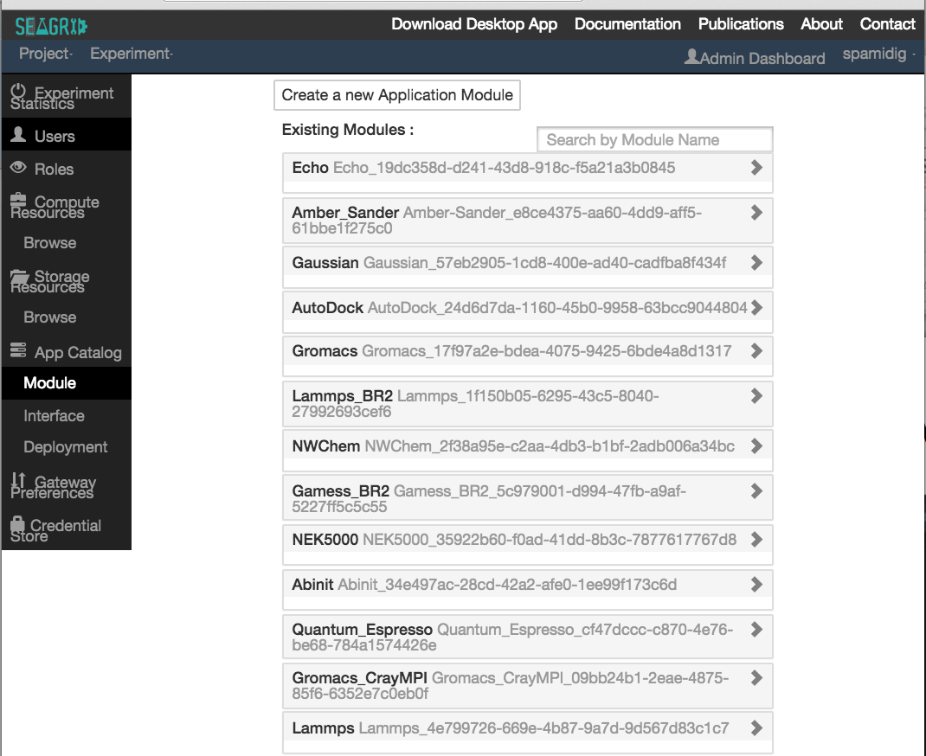
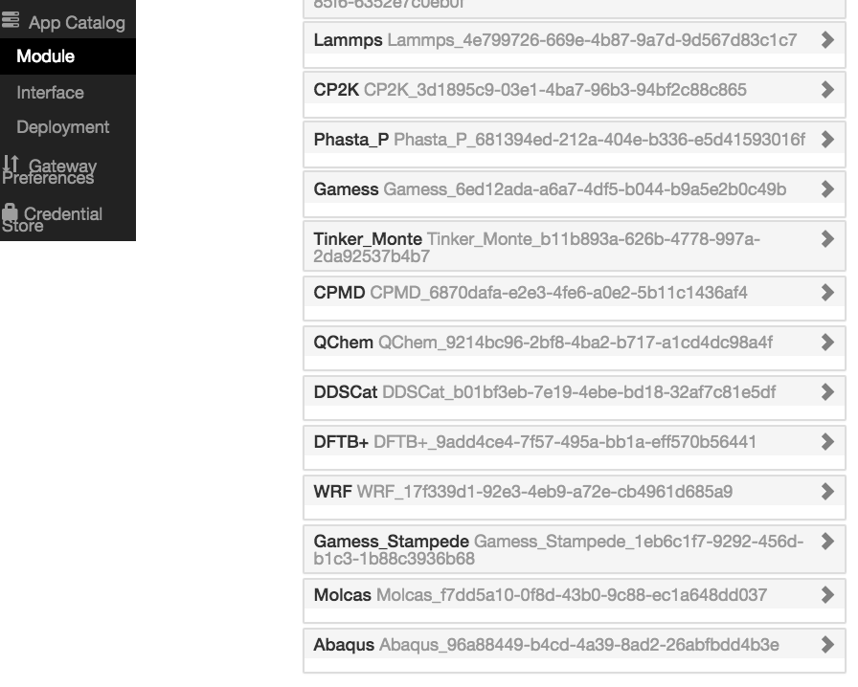
SEAGrid Application Catalog

Slide 31
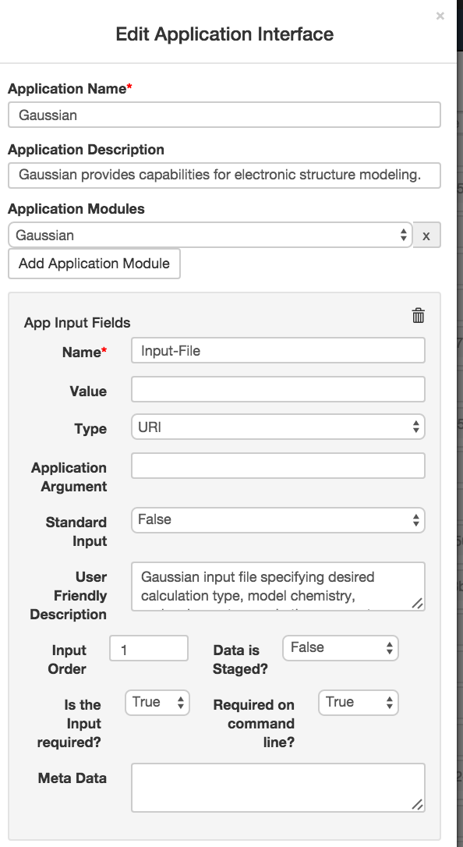
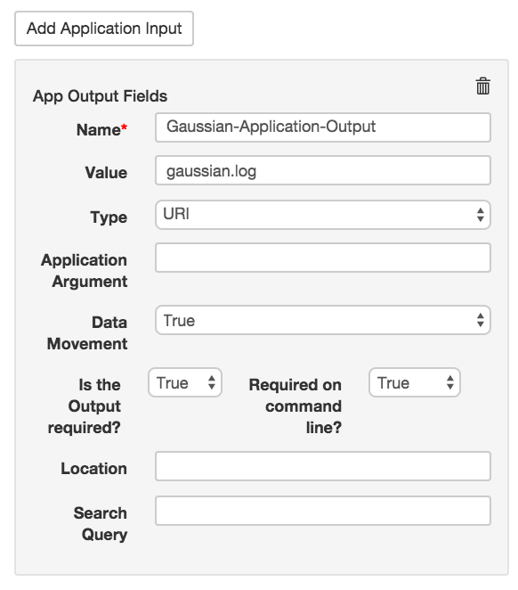
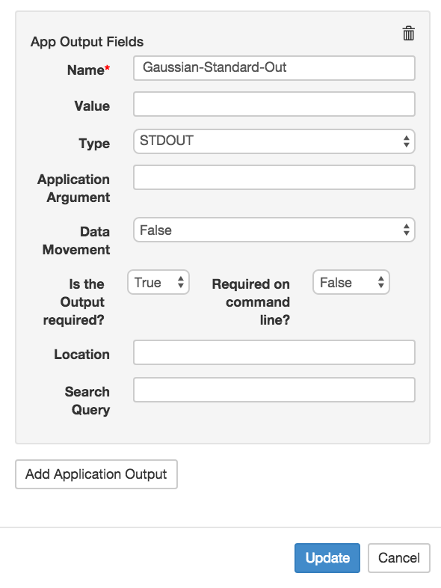
Application Interface Editor
Continued…

Slide 32
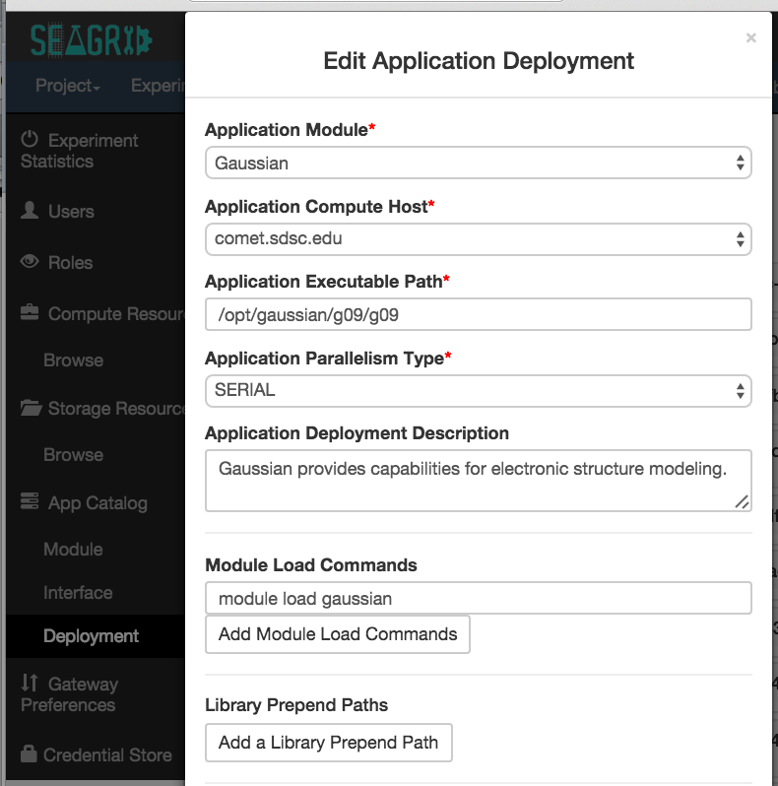
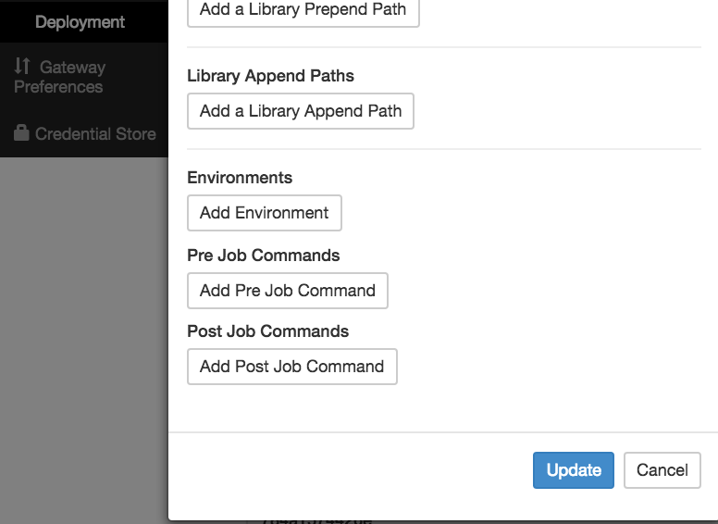
Application Deployment Editor
Continued…

Slide 33
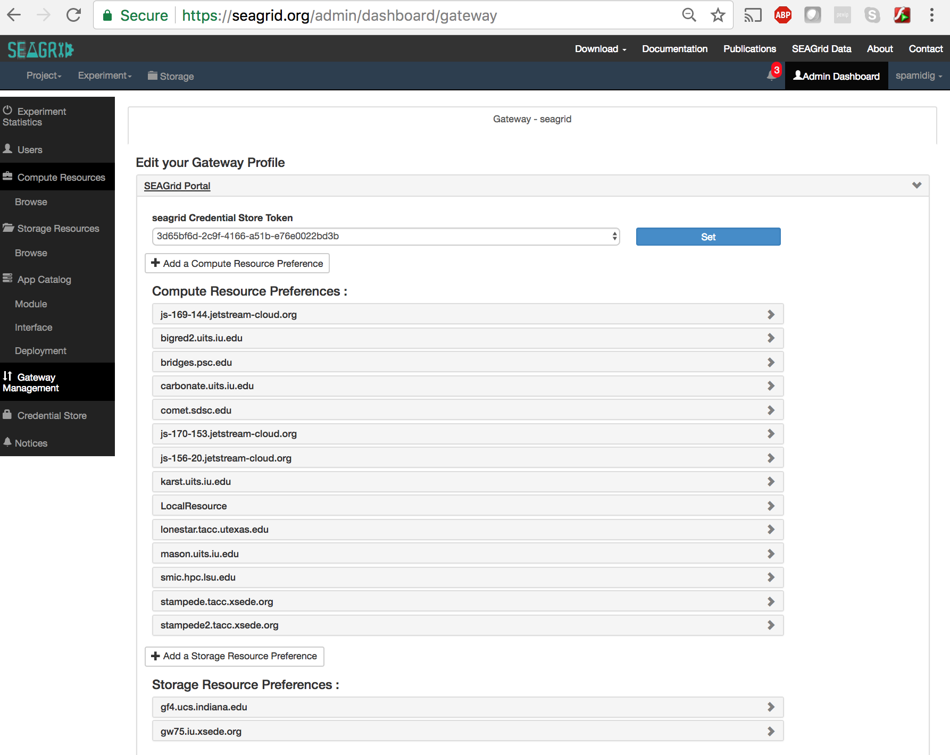
Gateway Profile

Slide 34
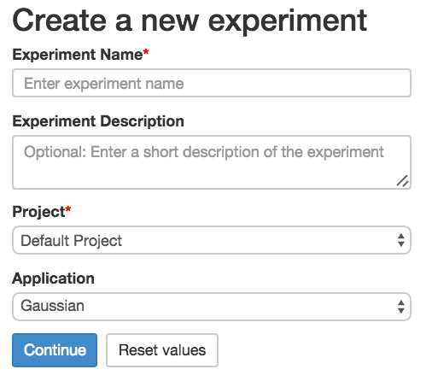
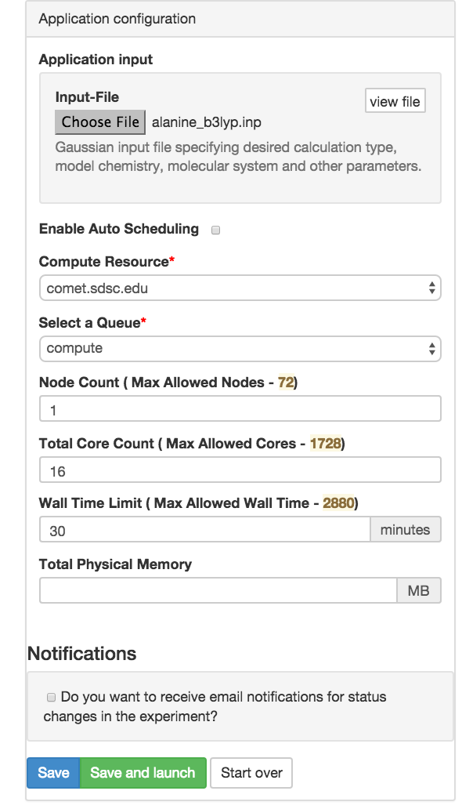
SEAGrid Experiment Creation

Slide 35
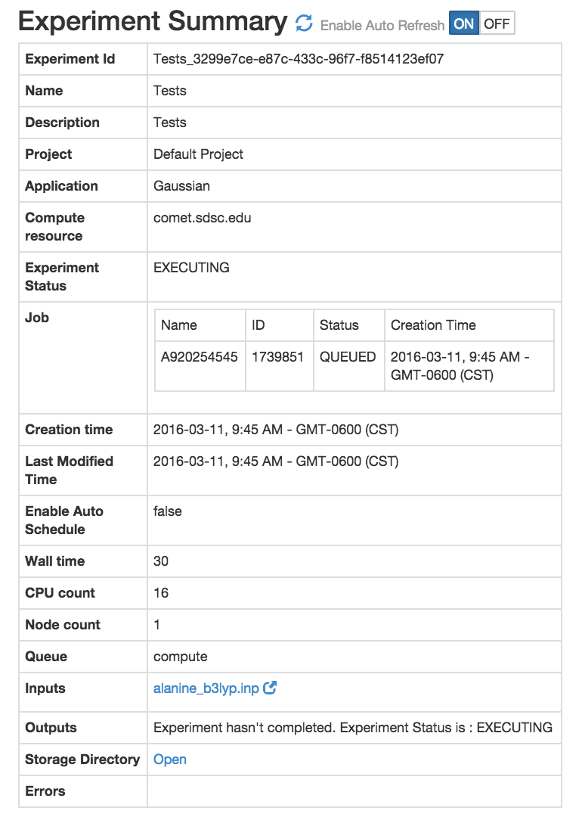
SEAGrid Experiment Status

Slide 36
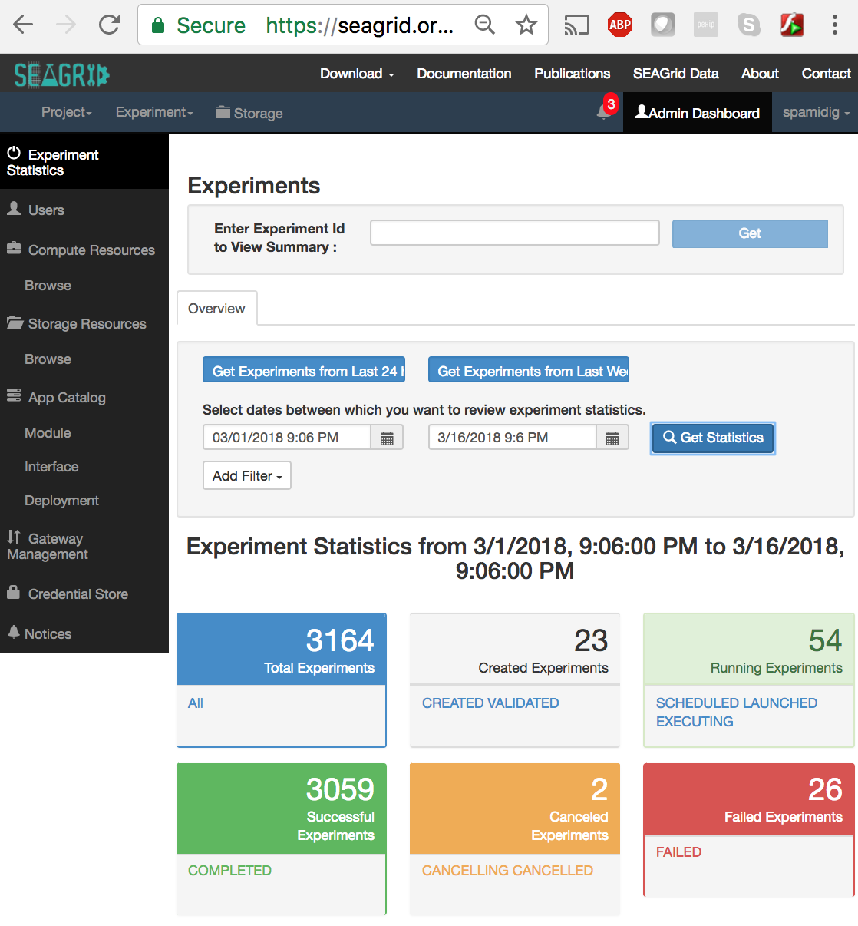
SEAGrid Admin Experiment Viewer

Slide 37
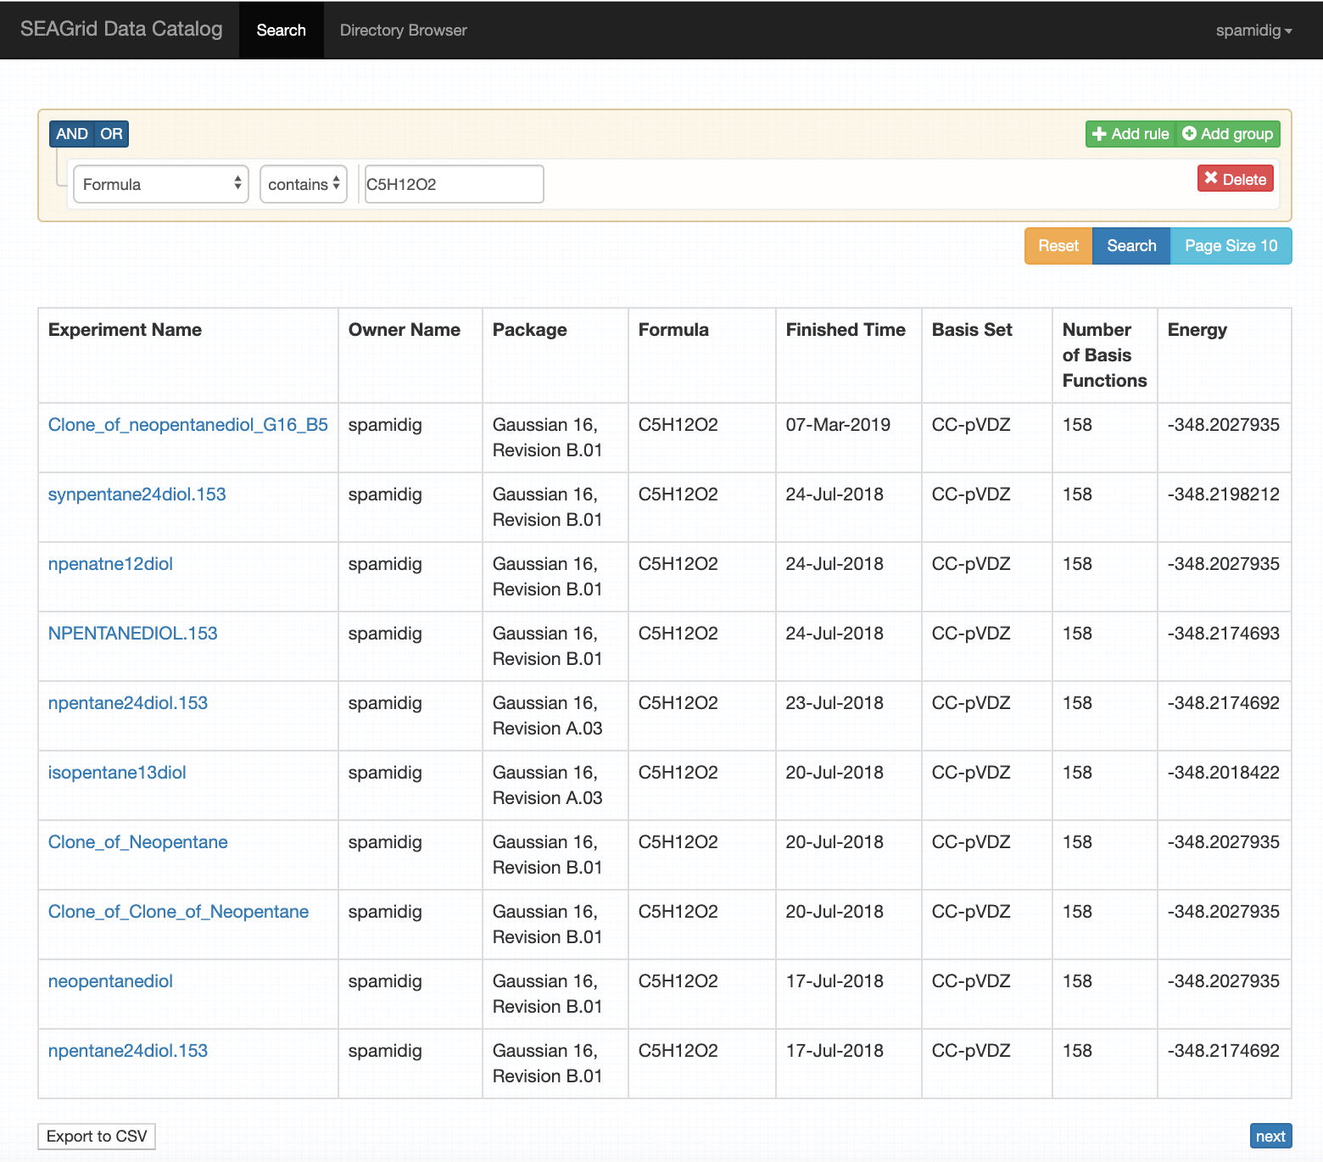
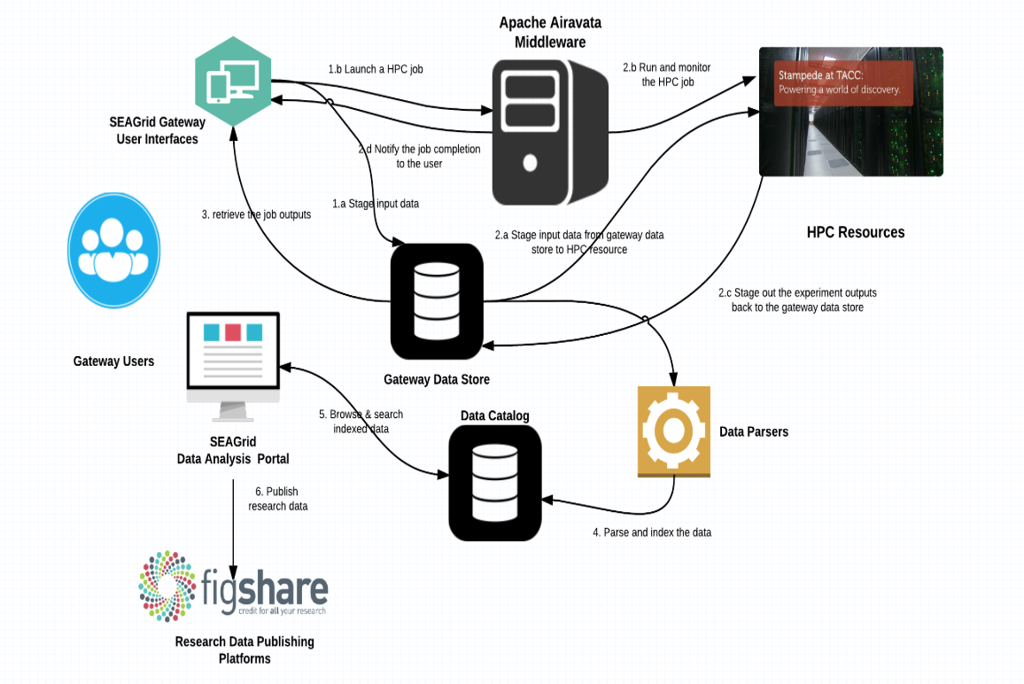
SEAGrid Data Catalog

Slide 38
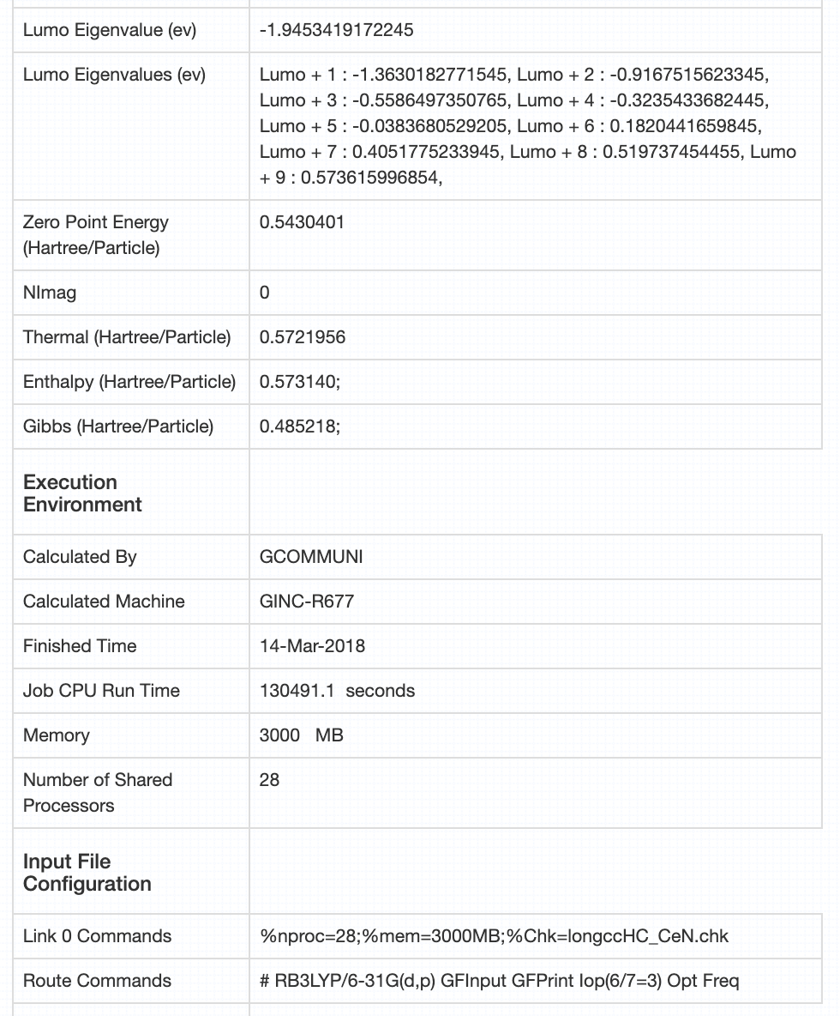
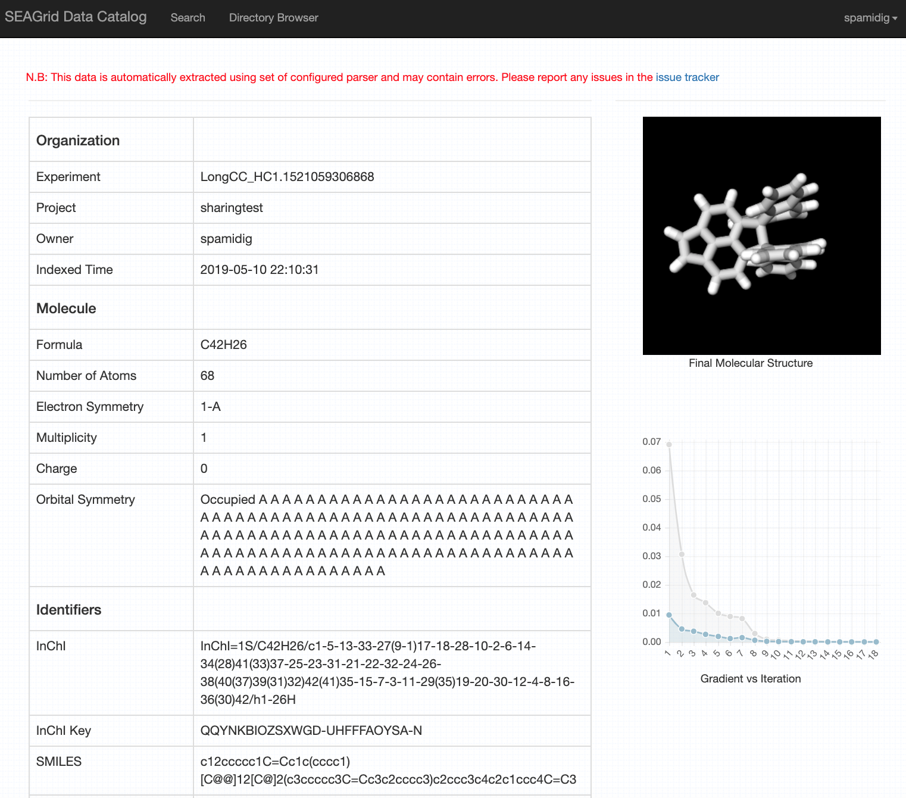
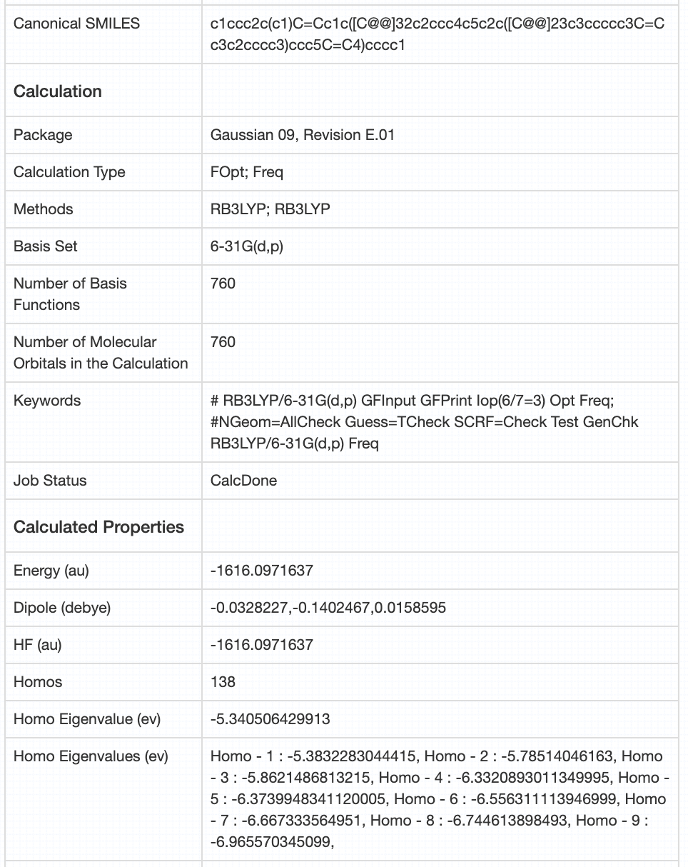
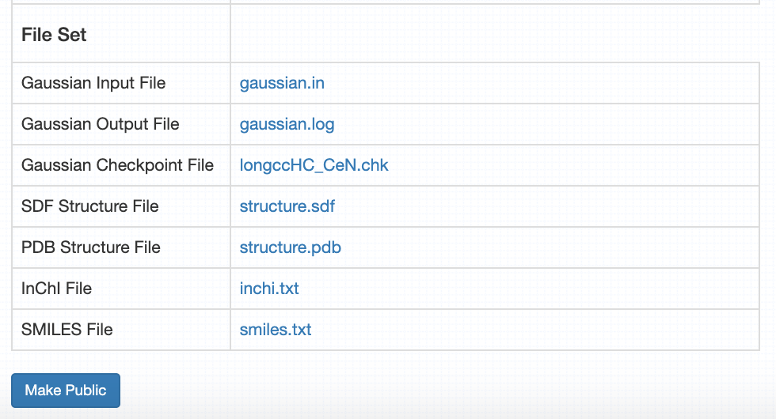
Output Metadata

Slide 39
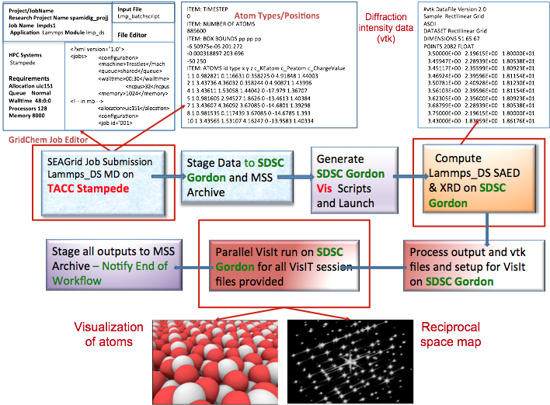
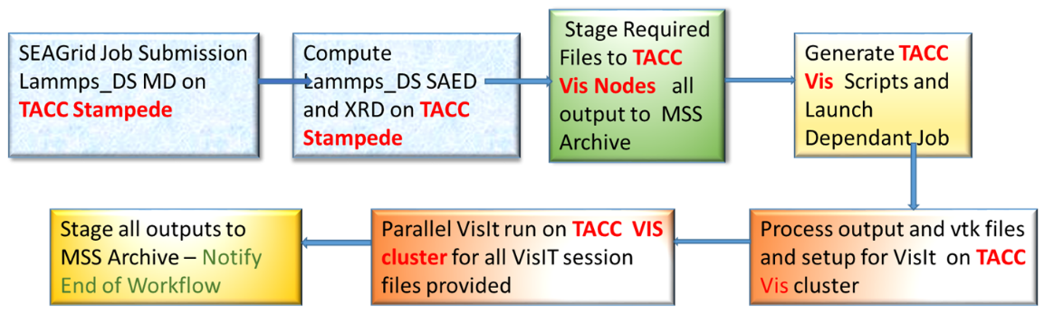
Workflow and Visualization An XSEDE ECSS Project
For large memory calculations a workflow is required to use the appropriate XSEDE resource
TACC Stampede: Atomistic simulation of alumina
SDSC Gordon: Calculation of diffraction intensities + Visualization
Workflow implemented through SEAGrid Science gateway
Supports a private “DS” LAMMPS build
Supports single job ID handle for multi-resource job submission
Supports the development of a XML script for high throughput job submission
Compatible with parallel VisIt executions so that diffraction pattern generation is automated
Workflow to run on TACC resources only
Workflow running on TACC and SDSC Resources

Slide 40

CaCO₃.xH₂O Initial guess
SEAGrid.org enabled workflow
Stampede Supercomputer
TINKER
Monte Carlo Molecular Mechanics
(Minimize Torsional Energy in <20,000 steps)
Stampede Supercomputer
DFTB+
Approximate DFT-Based
x=x+1
-2-3 CaCO3 Equilibrium Structures
-Thermochemistry (E,H,G, etc.)
-Vibrational Frequencies
Comet Supercomputer
Gaussian09
Ab initio Quantum Chemistry
Lopez-Berganza, et al. J Phys. Chem. A(2015)

Slide 41
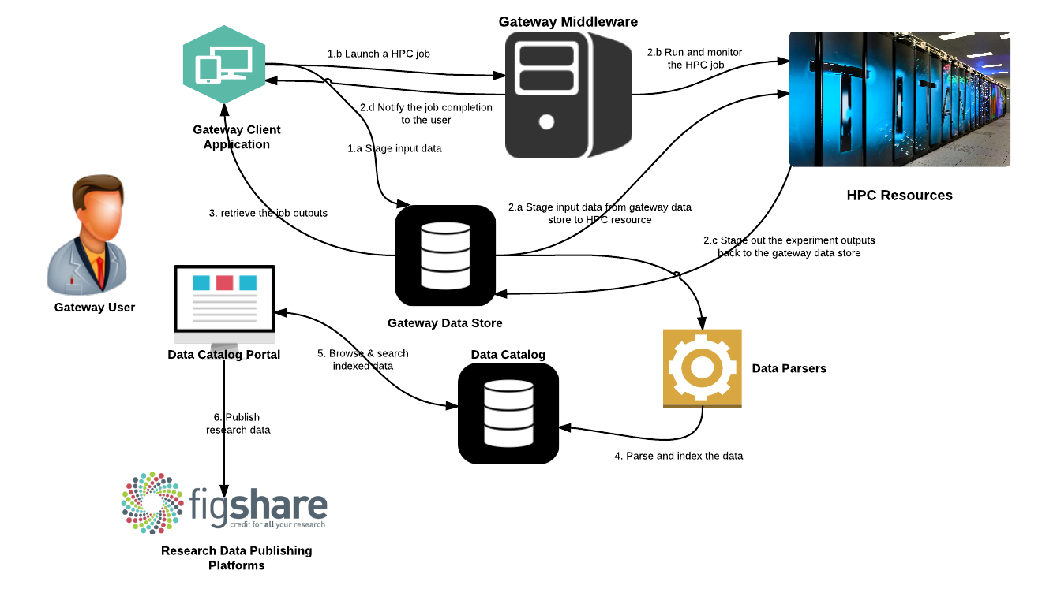
SEAGrid Data Catalog

Slide 42
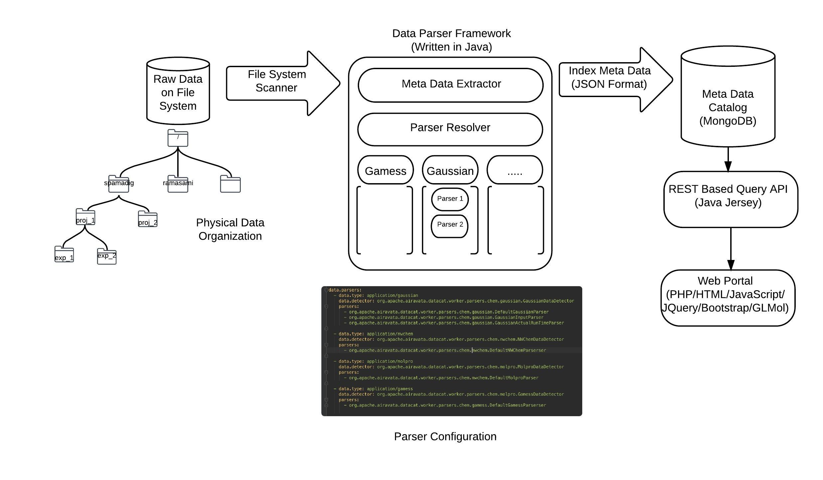
SEAGrid Data System Architecture

Slide 43
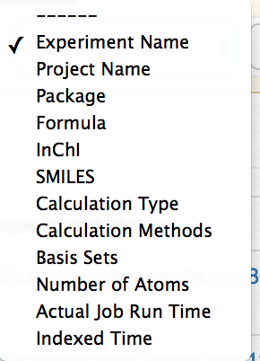

Searching for Cataloged Data

Slide 44



Output Metadata

Slide 45
Cyberinfrastructure Integration Research Center
Science Gateways Communities Institute EDS Activities
XSEDE ECSS-Gateways Collaborations
XSEDE ECSS ESRT/NIP Consulting
NSF Grants –OGCE, SciGaP, XSEDE, JetStream, Cyberwater, DELTA_Topology, Graph-theory-based molecular fragmentation methods
NASA Grants – GeoGateway
Private Sector Partnerships
https://circ.iu.edu/

Slide 46
Acknowledgements and Contacts
NSF Grants ACI-1547611, ACI-1339774
Apache Software Foundation
Indiana University
GSOC Programs
Science Gateways Research Center https://circ.iu.edu/
Center email: sgrc-iu-group@iu.edu
Marlon Pierce: marpierc@iu.edu, Director
Apache Airavata Open Source Science Gateway Softwar http://airavata.apache.org/
Sudhakar Pamidighantam pamidigs@iu.edu SEAGrid
Suresh Marru: smarru@iu.edu Apache Airavata

Slide 47





SEAGrid Desktop Client CSD Database Integration

Slide 48


Graphical Interfaces to Application Software

Slide 49

SEAGrid Desktop Client Storage Browser

